Slide 1
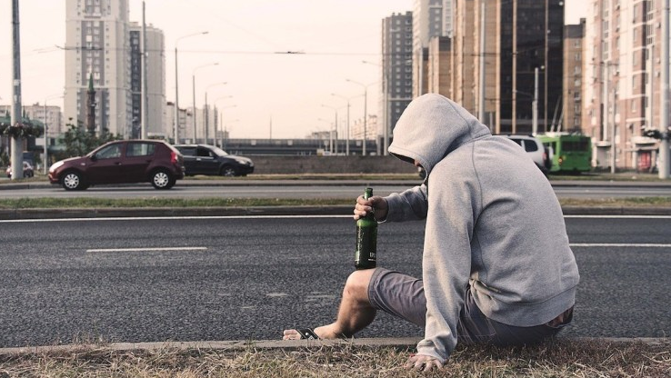

Los Angeles
Drinking x Crime
by
The Harmonious Hummingbirds
Andrew Wright
Jennie Chang
Leo Ramirez
Raymond Barry
Sanaz Shahbazian
Toshe Ayo-Ariyo

Slide 2
Purpose
Determine if there is a correlation between bar popularity and frequency of intoxication related crimes
This analysis will eventually enable us to implement a crime rating on yelp

Slide 3



DATA
SOURCES
X
Los Angeles Crime API (2016-2019)

Slide 4
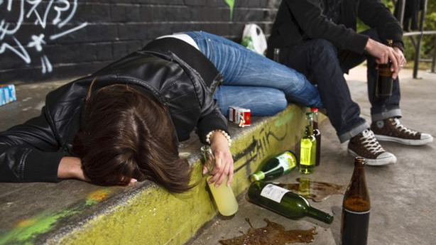
DEFINTION OF
Drunken Arrests
Crimes that include the following keywords:
Drunk
Drinking
Alcohol
DUI
Intoxication

Slide 5
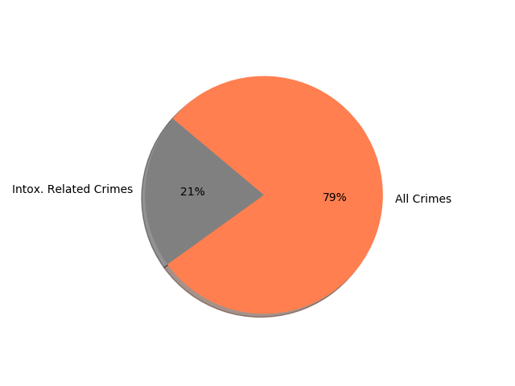
How does drunk-related arrests rank amongst different types of crime in LA?
Top 5 Crimes:
Drunk Diving (7.4%)
Drinking in Public (7.0%)
Corporal Injury on Spouse/Cohabitant (3.6%)
Possession of controlled substance (3.4%)
FTA after written promise (2.3%)

Slide 6
What intoxication related arrests are the most prevalent?

Slide 7
What gender is responsible for the majority of crimes?

Slide 8
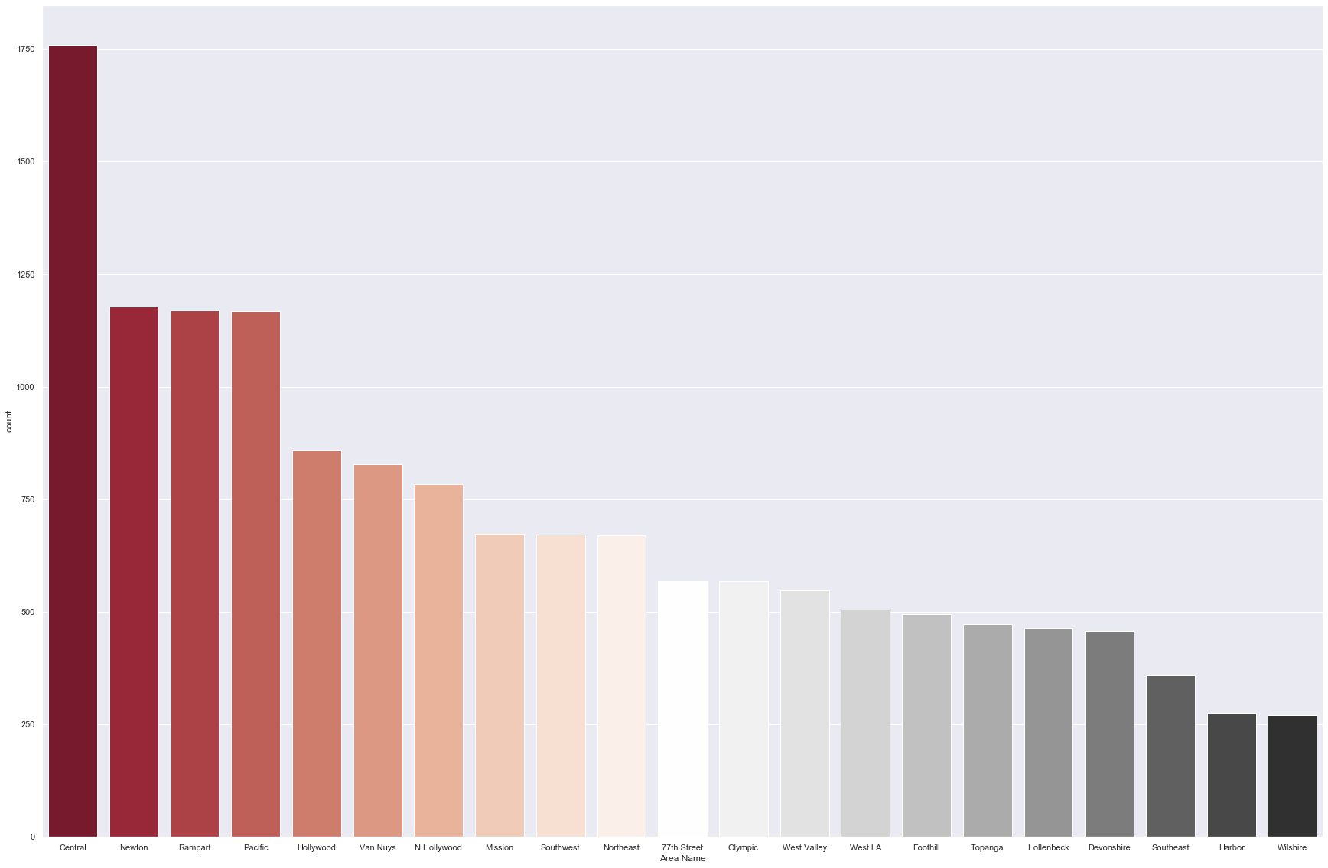
Where are the most arrests for public intoxication happening?

Slide 9
Where are the top visited bars in Los Angeles?

Slide 10
Proximity of drunken arrests to top 100 reviewed bars in LA

Slide 11
Is there a correlation of drunken arrests to $ - $$ bars vs $$$-$$$$ bars?

Slide 12


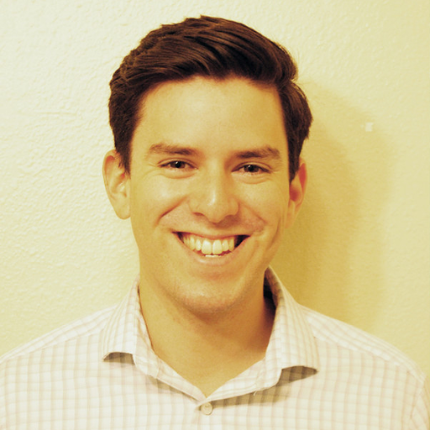

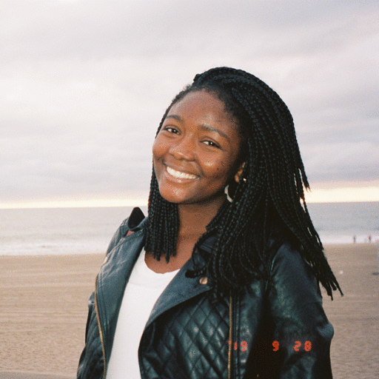

The Team
Andrew Wright
901 Bar & Grill
Jennie Chang
The Figueroa Hotel
Leo Ramirez
The Blind Donkey
Raymond Barry
The Venice Room
Toshe Ayo-Ariyo
Perch
Sanaz Shahbazian
The Standard

